Slide 1

Testing and Verification (CSC7056/CSC3056)
Aidan McGowan
Static testing

Slide 2



Static Testing
Unlike dynamic testing (which requires the execution of software) static testing relies on the manual examination (reviews) and automated analysis of the code or other project documentation without the execution of the code.
Much cheaper to detect (and remove) detects early in the lifecycle.

Slide 3
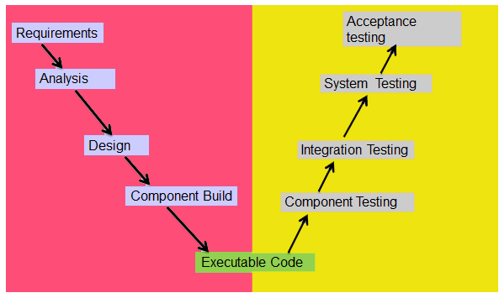
Static Testing
Dynamic Testing

Slide 4
Static Testing
Start early – as soon as documents are available e.g. requirements, design specs etc.
Purpose in documents
  Find defects :
    Errors
    Omissions
    Conflict
    Ambiguity

Slide 5
Static Testing and the Test Process
Static
Finds causes of failure (defects)
Finds them early
Defect cheap to fix
Dynamic
Finds the failures (defects) themselves
Finds them late
Defects expensive to fix

Slide 6
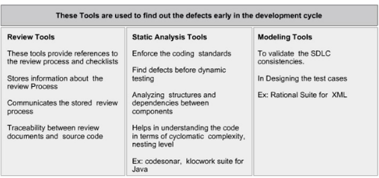
Static Tools

Slide 7



Reviews
Reviews are a way of testing software work products (including code)
May be performed well in advance of dynamic testing execution.
A review may be entirely manual or use tool support.
The main activity is to examine a work product and make comments about it.
Includes automated execution of code or other project documentation

Slide 8

Benefits of reviews
Early defect detection and correction
Development productivity improves
Reduced development timescales
Reduced testing time and cost
Lifetime cost reductions
Fewer defects
Improved communication

Slide 9
Review Types
The main review types that come under static testing
Inspection / Formal Review
Technical review
Walkthrough
Informal review
Formality
Effectiveness
Notes:
Reviewing requirements – what makes a good requirement
http://www.ibmpressbooks.com/articles/article.asp?p=1152528&seqNum=4
Unambiguous
Testable (verifiable)
Clear (concise, terse, simple, precise)
Correct
Understandable
Feasible (realistic, possible)
Independent
Atomic
Necessary
Implementation-free (abstract)

Slide 10
Inspection / Formal Reviews
Formal reviews follow a very formal process. It is well structured and regulated.
A formal review process consists of six main steps:
  Planning
  Kick-off (optional)
  Preparation
  Review meeting
  Rework
  Follow-up

Slide 11
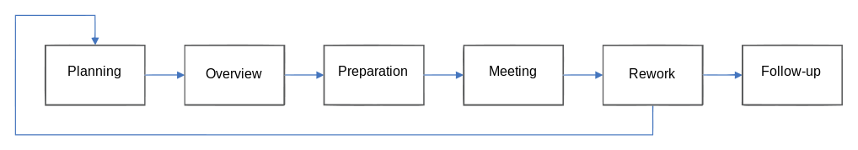
Inspection - steps
There are many varieties used in the industry. Most are based on the Michael Fagan inspection basic model (IBM Model)
Notes:
Fegan – Return on Investment of Formal Reviews (15% budget spent on reviews)
spent on review : saved in rework, bugs fixes etc
$ 1 : $2-3
$ 1 : $5
$ 1 : $8
$ 1 : $18 - $33

Slide 12
Inspection - Planning
Request for a review by the author to the moderator
A moderator responsible for scheduling date, time, place and invitation of the review.
The moderator performs the entry check and also defines the formal exit criteria.
The entry check is done to ensure that the reviewer’s time is not wasted on a document that is not ready for review.
After doing the entry check if the document is found to have very little defects then it’s ready to go for the reviews.

Slide 13
Inspection - Planning
Entry criteria
  The documents should not reveal a large number of major defects
  The documents to be reviewed should include line numbers.
  The documents should be cleaned up by running any automated checks that apply.
  The author should feel confident about the quality of the document so that he can join the review team with that document.

Slide 14
Inspection - Planning
Once, the document clears the entry check the moderator and author decides on which part of the document is to be reviewed.
Review limit is set to a maximum size 10 and 20 pages.
May only be one or two pages – very in-depth review
Depends on the objective and document type.

Slide 15
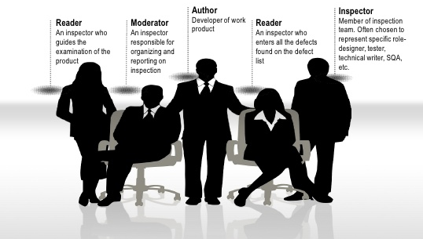
Inspection - Planning
Four to six participants (including moderator and author)
Moderator assigns to roles.

Slide 16
Inspection - Kick-off(optional)
Gives a short introduction on the objectives of the review and the documents to everyone in the meeting.
The relationships between the document under review and the other documents are also explained, especially if the numbers of related documents are high.
At customer sites, measured results of up to 70% more major defects found per page as a result of performing a kick-off, [van Veenendaal and van der Zwan, 2000].

Slide 17
Inspection – Individual preparation
The reviewers review the document individually using the related documents, procedures, rules and checklists provided.
Each participant while reviewing individually identifies the defects, questions and comments according to their understanding of the document and role.
All issues are recorded using a logging form.
The success factor for a thorough preparation is the number of pages checked per hour. This is called the checking rate. Usually the checking rate is in the range of 5 to 10 pages per hour.

Slide 18




Inspection – examination/ evaluation/ recording of results (review meeting)
Three phrases
Logging phase
Discussion phase
Decision phase

Slide 19
Inspection – Review meeting Logging phase
All issues and the defects that have been identified during the preparation step are logged page by page.
The logging is basically done by the author or by a scribe.
Every defect and severity should be logged :
– Critical: The defects will cause downstream damage.
– Major : The defects could cause a downstream damage.
– Minor : The defects are highly unlikely to cause the downstream damage.
Notes:
During the logging phase the moderator focuses on logging as many defects as possible within a certain time frame and tries to keep a good logging rate (number of defects logged per minute). In formal review meeting the good logging rate should be between one and two defects logged per minute.

Slide 20
Inspection – Review meeting Discussion phase
If any issue needs discussion then the item is logged and then handled in the discussion phase.
The moderator takes care of the people issues and prevents discussion from getting too personal and calls for a break to cool down the heated discussion.
The outcome of the discussions is documented for the future reference.

Slide 21
Inspection – Review meeting Discussion phase
At the end of the meeting a decision on the document under review has to be made by the participants, sometimes based on formal exit criteria.
Exit criteria are the average number of critical and/or major defects found per page (for example no more than three critical/major defects per page).
If the number of defects found per page is more than a certain level then the document must be reviewed again, after it has been reworked.

Slide 22
Inspection - Rework
Fixing defects found.
  Not every defect that is found leads to rework. It is the author’s responsibility to judge whether the defect has to be fixed.
  If nothing can be done about an issue then at least it should be indicated that the author has considered the issue.
Changes should be traceable (Track changes in word processing software).

Slide 23
Inspection – Follow-up
The moderator checks to make sure that the author has taken action on all known defects.
If it is decided that all participants will check the updated documents then the moderator takes care of the distribution and collects the feedback.
It is the responsibility of the moderator to ensure that the information is correct and stored for future analysis.

Slide 24
Technical Reviews
It is a less formal review than an Inspection
It is led by the trained moderator but can also be led by a technical expert
It is often performed as a peer review without management participation
Defects are found by the experts (such as architects, designers, key users) who focus on the content of the document.
In practice, technical reviews vary from quite informal to very formal

Slide 25
Technical Reviews - goals
To ensure that an early stage the technical concepts are used correctly
To access the value of technical concepts and alternatives in the product
To have consistency in the use and representation of technical concepts
To inform participants about the technical content of the document

Slide 26
Walkthrough
May be formal or informal process
It is led by the authors
Author guides the participants through the document according to his or her thought process to achieve a common understanding and to gather feedback.
Useful for the people if they are not from the software discipline, who are not used to or cannot easily understand software development process.
Is especially useful for higher level documents like requirement specification, etc.

Slide 27
Walkthrough - goals
To present the documents both within and outside the software discipline in order to gather the information regarding the topic under documentation.
To explain or do the knowledge transfer and evaluate the contents of the document
To achieve a common understanding and to gather feedback.
To examine and discuss the validity of the proposed solutions

Slide 28
Informal reviews
Not based on a formal process
Could be :
  Paired programming
  Technical lead reviewing designs and code
  Varies in usefulness
Inexpensive and quick

Slide 29
Success factors for reviews
Reviews range in cost from relatively inexpensive (informal) to very expensive (Inspections)
Objectives
Clear predefined objectives
Suitable techniques applied (type and level of products and reviews)
People
Right People (skill levels)
Includes testers
People issues are managed
Mindset
Defects welcomed
Trustful atmosphere
Support
Checklists
Training
Management support
Emphasis on learning and process improvements

Slide 30
Exam Questions

Slide 31
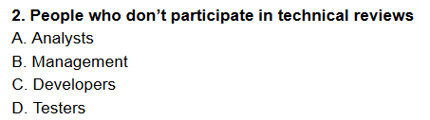
Notes:
B

Slide 32
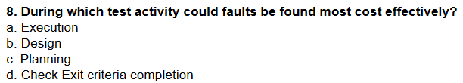
Notes:
C

Slide 33
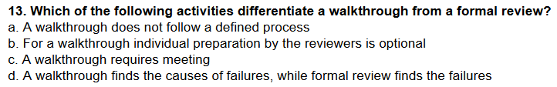
Notes:
B

Slide 34
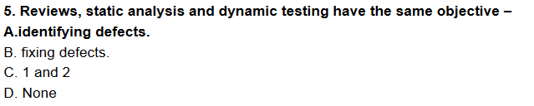
Notes:
A

Slide 35
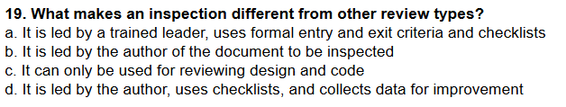
Notes:
A

